Slide 1
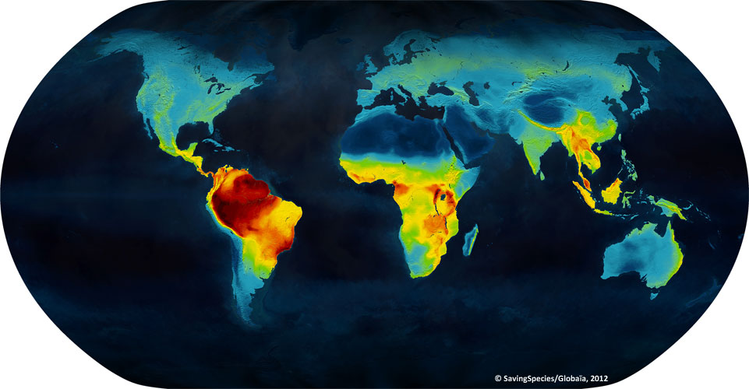
Biodiversity patterns

Slide 2
Motivating questions
Why is species diversity distributed so non-randomly on the surface of the Earth?
What are the most common patterns in biodiversity, are they universal?
What can exceptions tell us about the rule?
Are latitudinal and elevational gradients equivalent?
What theory closely explains the patterns?

Slide 3
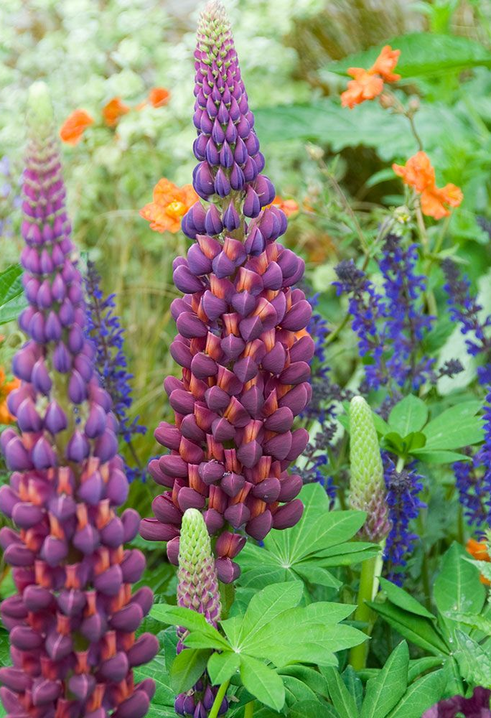
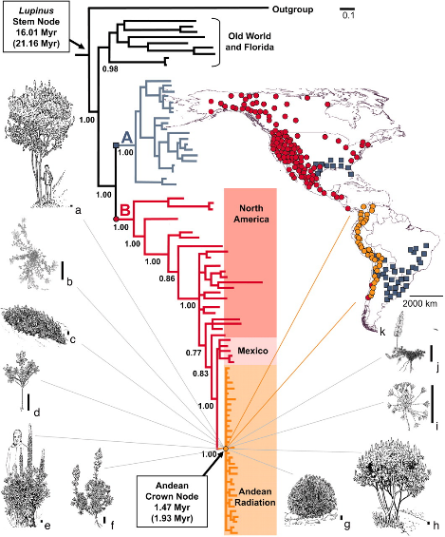
Evolution of Lupinus diversity in the New World
Hughes et al. (2006) PNAS

Slide 4
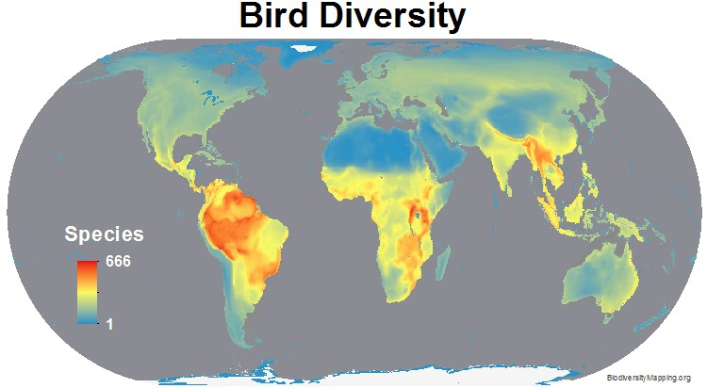
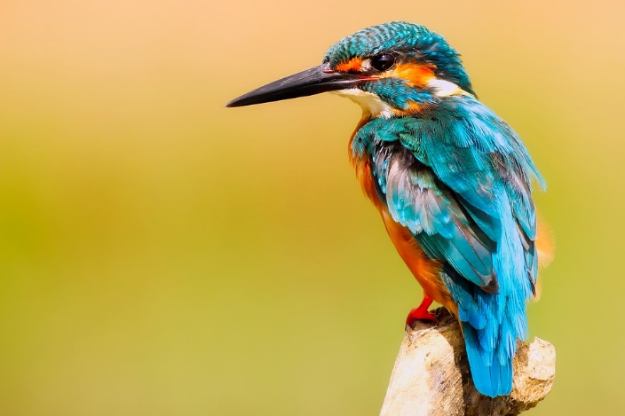
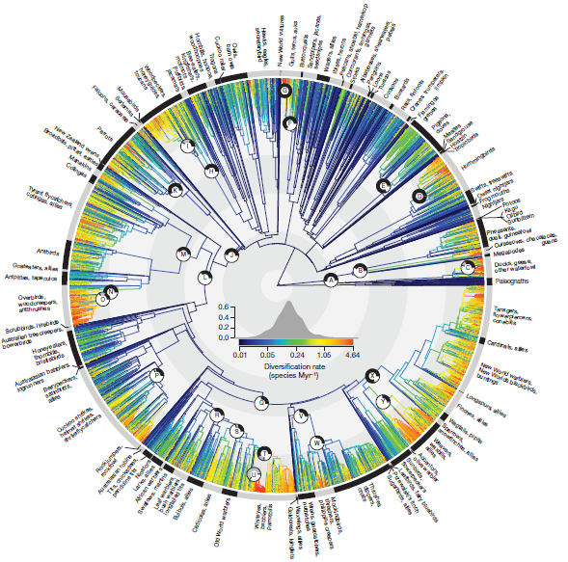
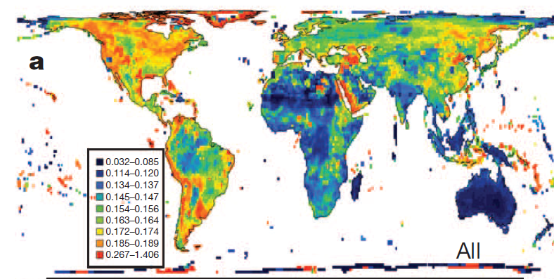
Why is the biodiversity of birds
conspicuously concentrated in the tropics?
Bird Diversification
Phylogeny-based analyses across geographic regions, coupled with the knowledge of historical dispersals reveal the role of ecology and evolution in shaping diversity patterns in birds
Jetz et al. (2012) Nature

Slide 5
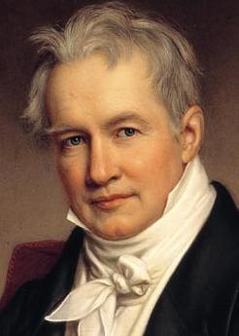
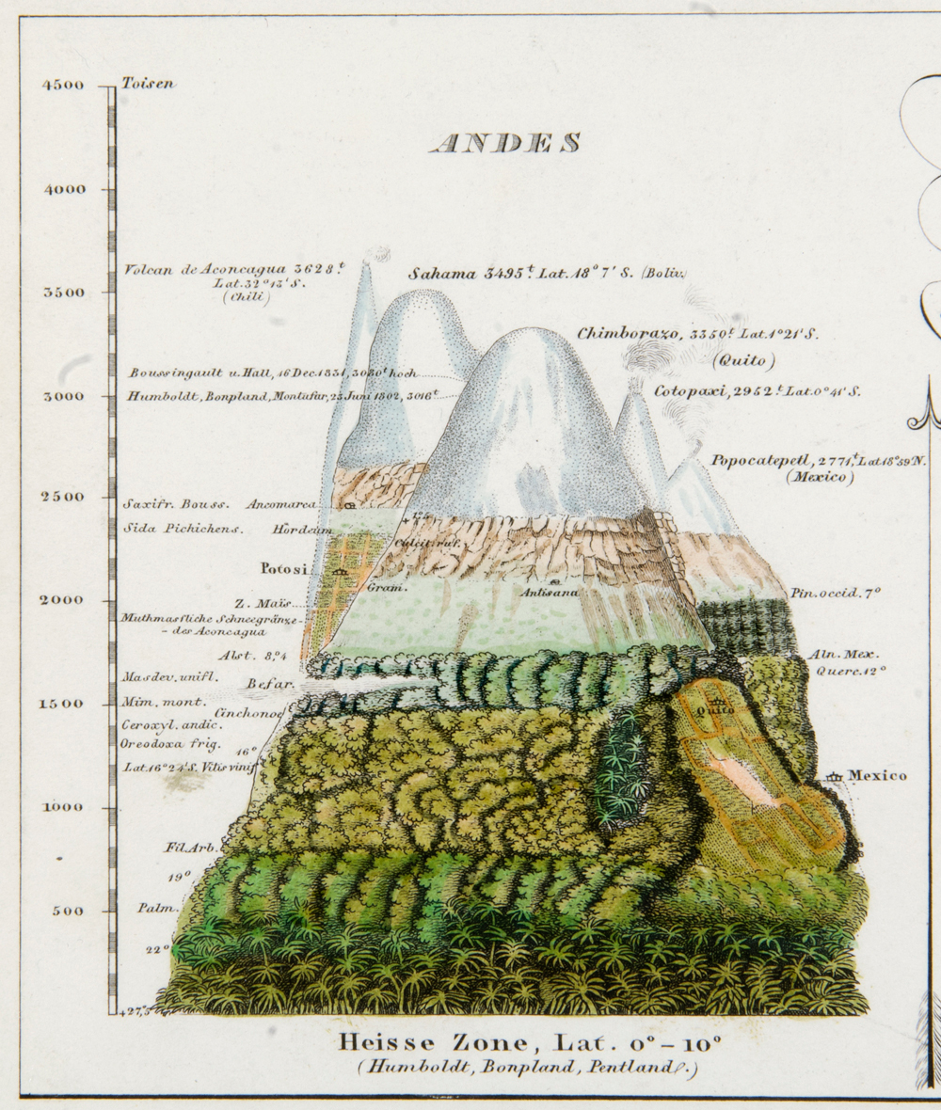
MOTIVATED THE HOLY GRAIL QUESTION IN BIOLOGY
Why are species non-randomly distributed in geographic space?
1799
amphibians
Notes:
One of the key figures in the study of nature is Alexander von Humboldt. Historians of science actually credit Humboldt with the “invention of nature”. The concept of nature supposedly did not historically exist before he formulated it through his work. We therefore now have nature as subject of study.
Humboldt also started retreats in the field. He also identified some of the key questions in biology. When he was about my age, he traveled into the Amazon. During his travels, he noticed that there are many more species in the tropics (compared to temperate) and many more species in lowlands (especially in the Andes) compared to the highlands.
Today, these patterns are known as the latitudinal diversity gradient. And the elevational diversity gradient.

Slide 6
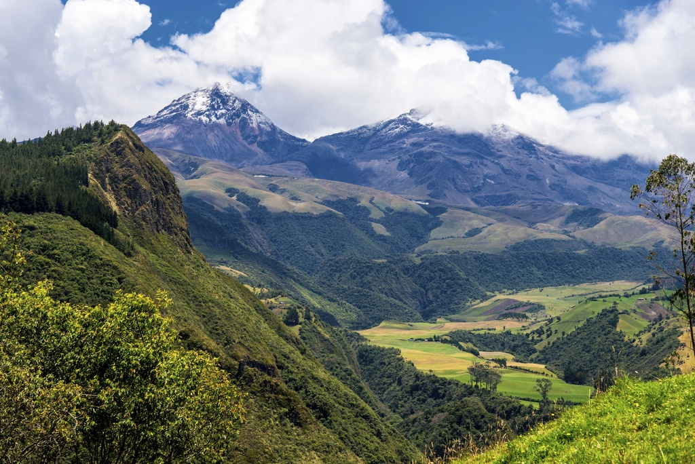
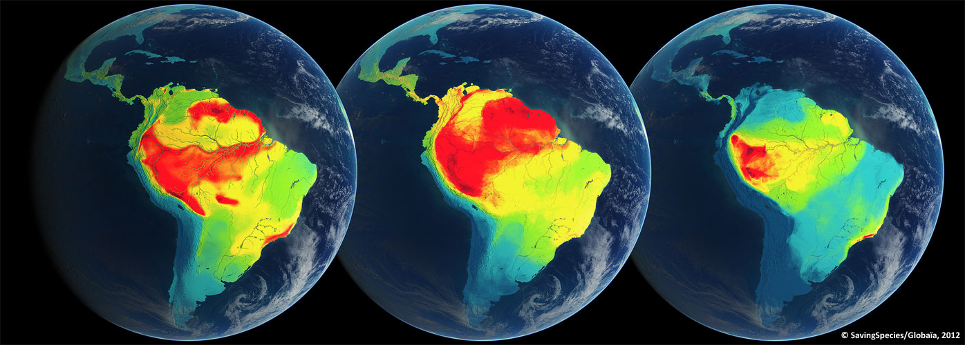
birds
mammals
amphibians
Notes:
These patterns have since been reported repeatedly and seem ubiquitous. Namely, they emerge across taxa, across continents, and across geological time periods, across montane systems, etc.
Here, we have the patterns for birds, mammals, and amphibians

Slide 7
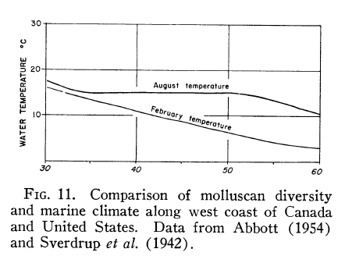
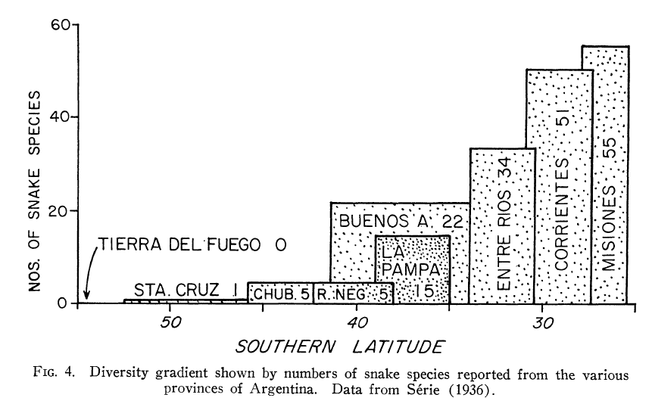
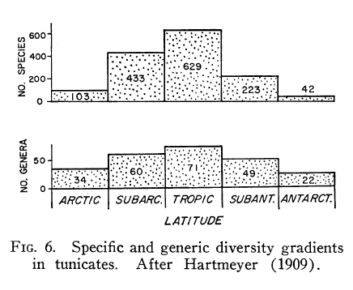
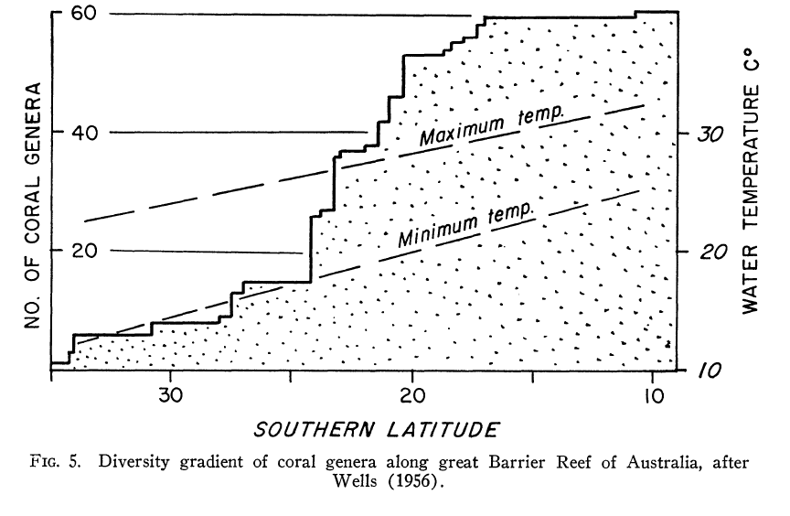
Examples of the pattern compiled by Fischer (1960) Evolution. Seminal paper (1000+ citations)
Snakes of Argentina
Molluscs of Canada
Corals in Australia
Tunicates worldwide
Notes:
The universality of diversity patterns (especially with latitude and elevation) has been popularized and established in the 60’s. Here are some of the figures from the seminar paper by Fischer, where he demonstrates the patterns across multiple taxa. He also offers preliminary hypotheses for the pattern
This is how research typically works.

Slide 8
THREE BIODIVERSITY PATTERNS
latitudinal diversity gradient
elevational diversity gradient
species-area relationship

Slide 9
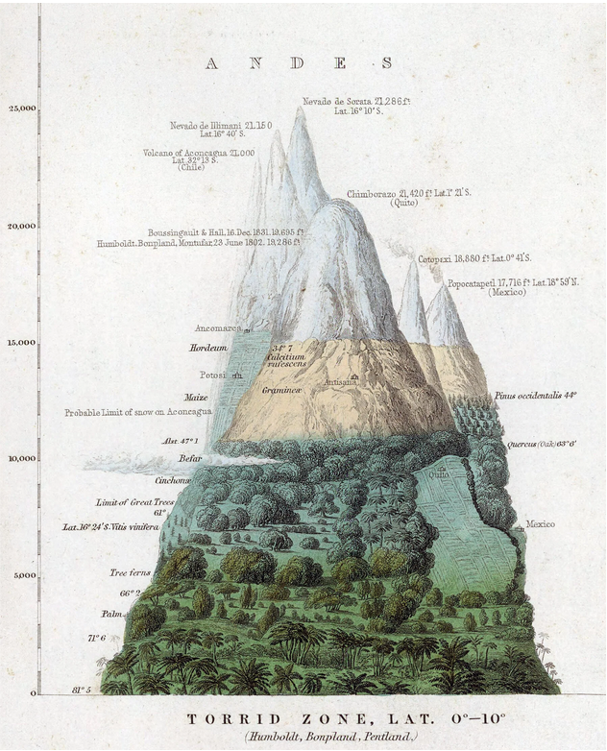
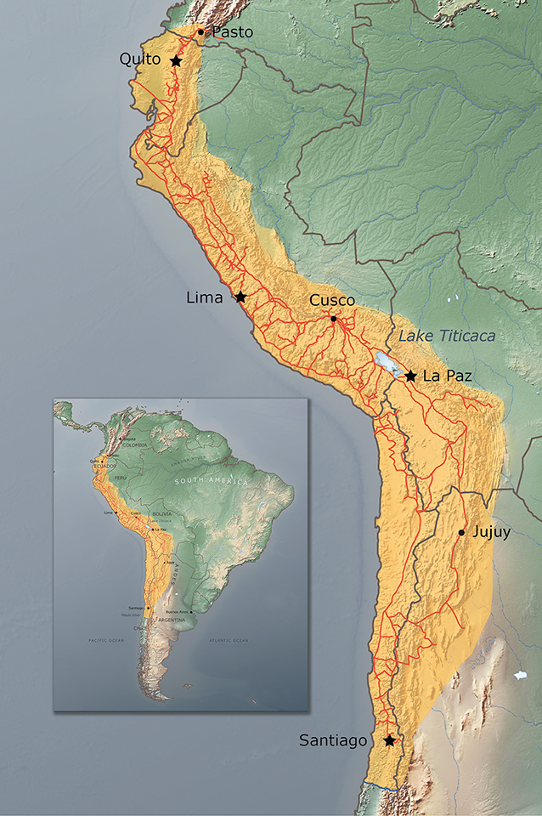
Elevational diversity gradient
Humboldt
(1799)
climate and vegetation change
diversity declines
mirroring the latitudinal gradient

Slide 10
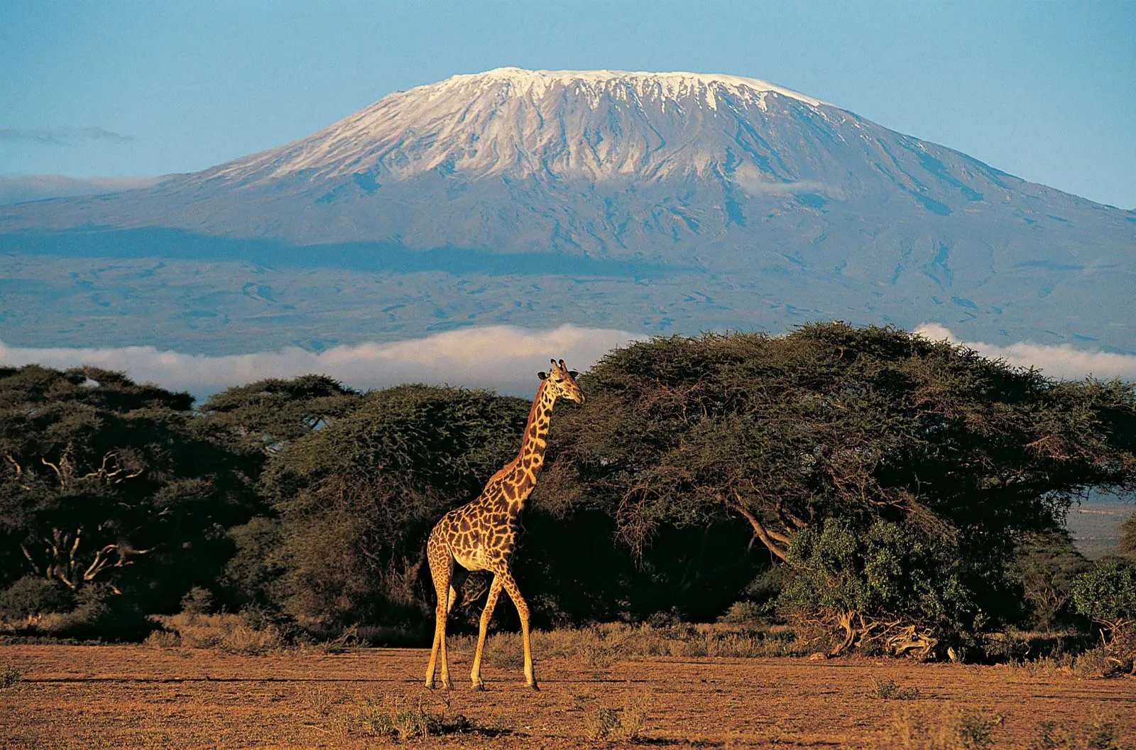
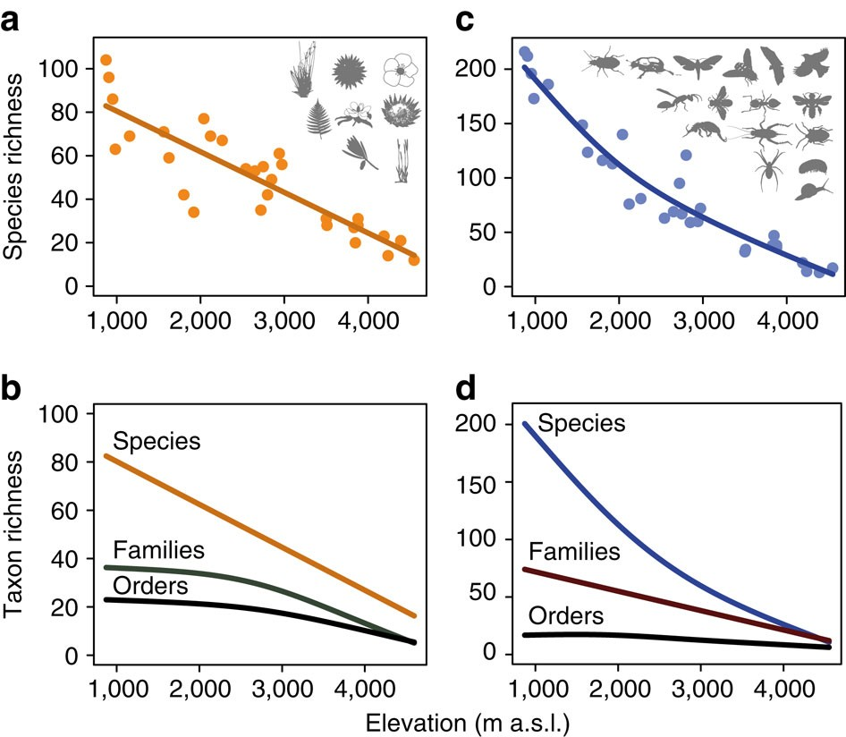
Elevational diversity gradient
Peters et al. (2016) Mt Kilimajaro
diversity of plants, insects, vertebrates
elevation (meters)

Slide 11
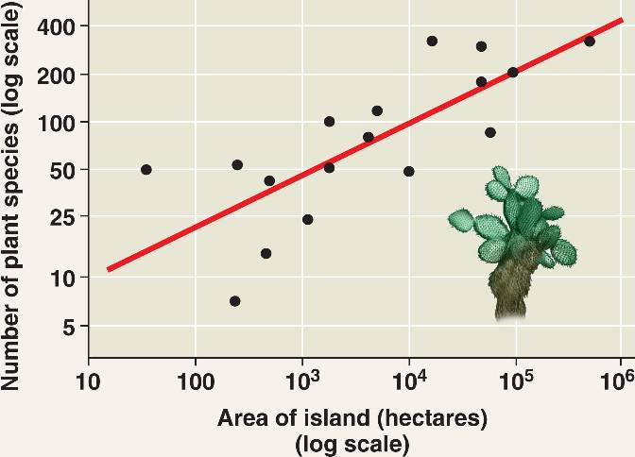
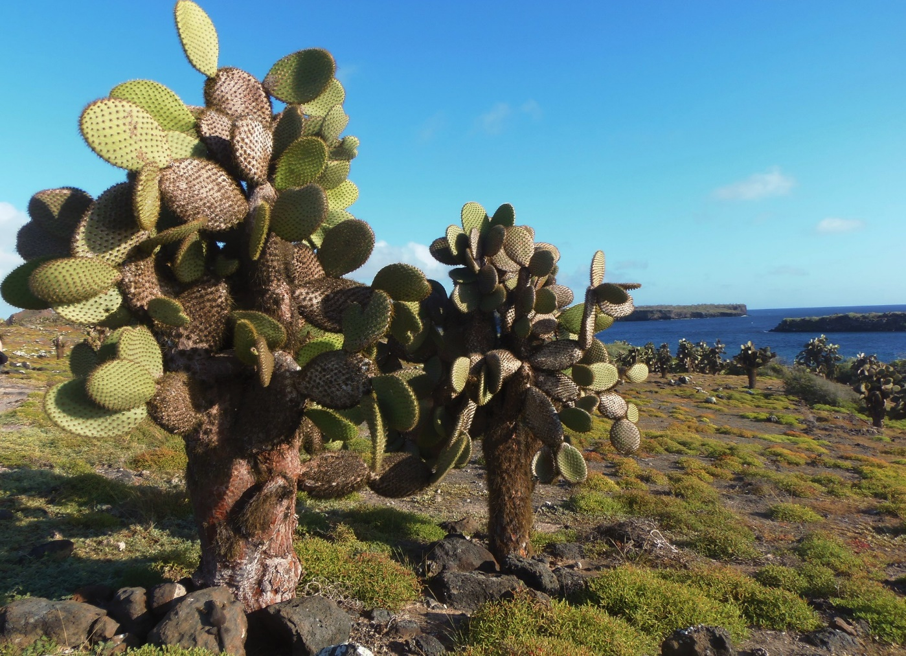
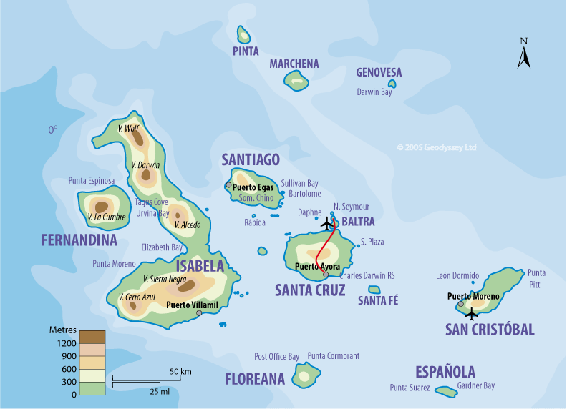
species-area relationship
vascular plants of the Galapagos (MacArthur and Wilson 1964)

Slide 12
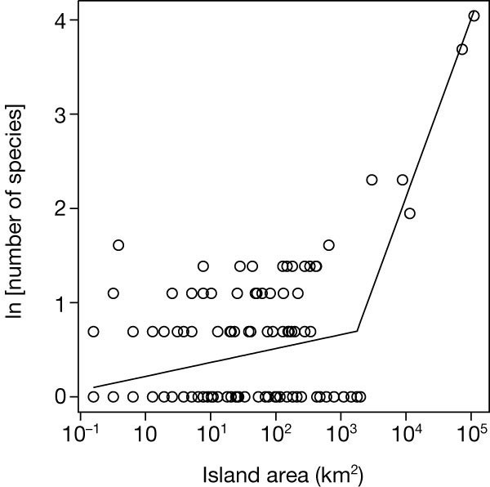
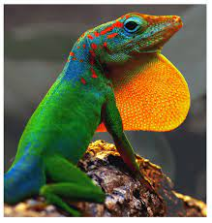
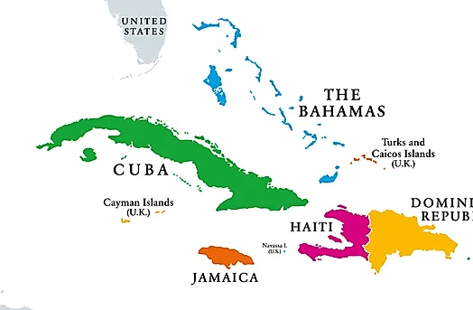
species-area relationship
Evolutionary
species-area relationship
minimum island size for allopatric speciation to happen. Study system: Anolis lizards of Caribbean islands. Losos and Schluter (2000) Nature

Slide 13
BIODIVERSITY PATTERNS
latitudinal diversity gradient
elevational diversity gradient
species-area relationship

Slide 14
Examples of the pattern compiled by Fischer (1960) Evolution. Seminal paper (1000+ citations)
Snakes of Argentina
Molluscs of Canada
Corals in Australia
Tunicates worldwide
Notes:
The universality of diversity patterns (especially with latitude and elevation) has been popularized and established in the 60’s. Here are some of the figures from the seminar paper by Fischer, where he demonstrates the patterns across multiple taxa. He also offers preliminary hypotheses for the pattern
This is how research typically works.

Slide 15
Typically, we first establish that there is a biological pattern. Then, we formulate theory to explain the pattern from which we derive hypotheses and predictions. These are then tested on newly collected data, independent from the data that inspired the theory in the first place.
Examples of the pattern compiled by
Fischer (1960) Evolution
Seminal paper (1000+ citations)
Notes:
The universality of diversity patterns (especially with latitude and elevation) has been popularized and established in the 60’s. Here are some of the figures from the seminar paper by Fischer, where he demonstrates the patterns across multiple taxa. He also offers preliminary hypotheses for the pattern
This is how research typically works. First, we need to establish a pattern. What is out there. Then, we can formulate explanation: theory, hypotheses. We typically need to collect more data to test these theories. Data that is independent from the data that inspired the theory in the first place

Slide 16
Typically, we first establish that there is a biological pattern. Then, we formulate theory to explain the pattern from which we derive hypotheses and predictions. These are then tested on newly collected data, independent from the data that inspired the theory.
Examples of the pattern compiled by
Fischer (1960) Evolution
Seminal paper (1000+ citations)
The new data helps to reject some of the hypotheses and predictions, and to refine the theory. The refined theory is then again revisited against new data, and further developed.
Notes:
The universality of diversity patterns (especially with latitude and elevation) has been popularized and established in the 60’s. Here are some of the figures from the seminar paper by Fischer, where he demonstrates the patterns across multiple taxa. He also offers preliminary hypotheses for the pattern
This is how research typically works. First, we need to establish a pattern. What is out there. Then, we can formulate explanation: theory, hypotheses. We typically need to collect more data to test these theories. Data that is independent from the data that inspired the theory in the first place

Slide 17
Typically, we first establish that there is a biological pattern. Then, we formulate theory to explain the pattern from which we derive hypotheses and predictions. These are then tested on newly collected data, independent from the data that inspired the theory.
Examples of the pattern compiled by
Fischer (1960) Evolution
Seminal paper (1000+ citations)
The new data helps to reject some of the hypotheses and predictions, and to refine the theory. The refined theory is then again revisited against new data, and further developed.
Following this hermeneutical circle, we gradually approximate the truth
Fischer 1960
Notes:
The universality of diversity patterns (especially with latitude and elevation) has been popularized and established in the 60’s. Here are some of the figures from the seminar paper by Fischer, where he demonstrates the patterns across multiple taxa. He also offers preliminary hypotheses for the pattern
This is how research typically works. First, we need to establish a pattern. What is out there. Then, we can formulate explanation: theory, hypotheses. We typically need to collect more data to test these theories. Data that is independent from the data that inspired the theory in the first place

Slide 18
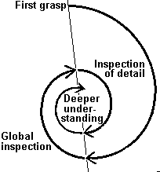
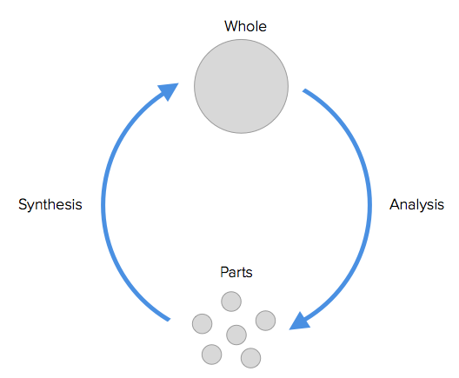
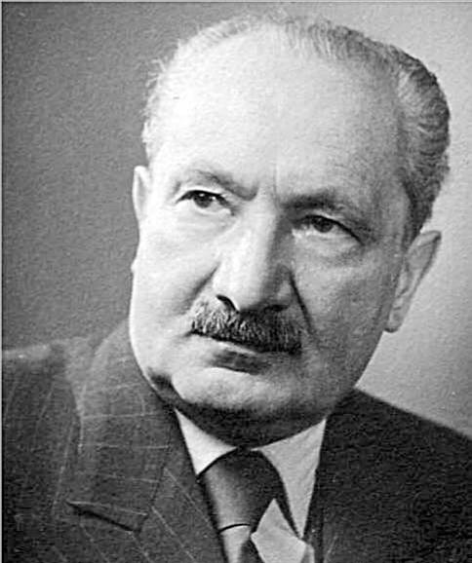
Hermeneutic circle in the methodology of science
Martin Heidegger (1927)

Slide 19
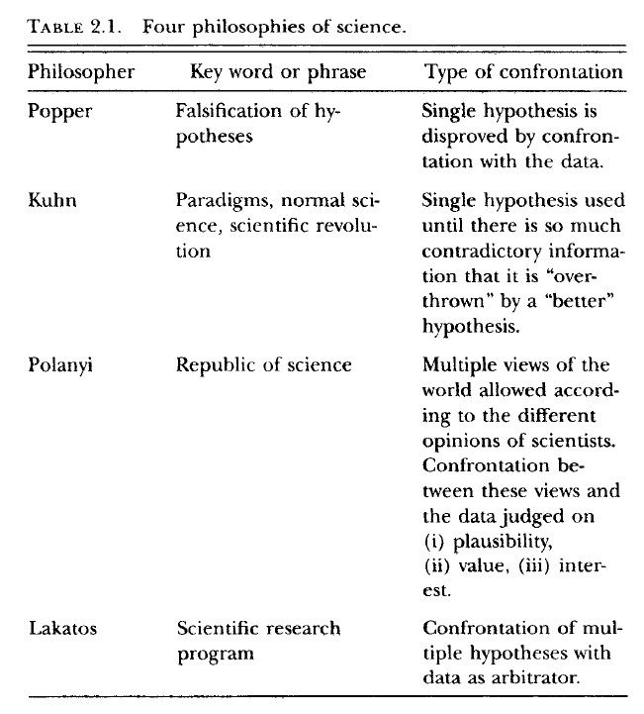
Book: Ecological detective
(Mangel 1997)

Slide 20
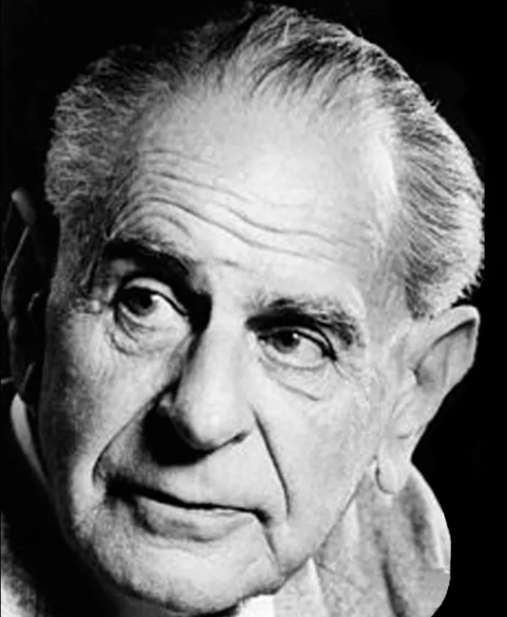
Book: Ecological detective
(Mangel 1997)
Popper
Single hypothesis confronted with data
Key role of an experiment
Falsification as the only truth
p - value testing
book in 1934
as 32 years old

Slide 21

Book: Ecological detective
(Mangel 1997)
Hypothesis confronted with large body of evidence before it can be disproven
Tests and data have limited strength
Truth exists only within the paradigm
Definition of a proper test is part of the paradigm itself
p - value testing
AIC testing
Bayesian and likelihood inference
1962
Kuhn
1962

Slide 22
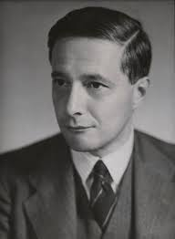
Book: Ecological detective
(Mangel 1997)
Republic of Science. Practice of science passed from master to apprentice. Implicit knowledge, rules, skills
Conformity balanced by originality
Confrontation not between models and data, but between models
AIC testing
Bayesian and likelihood inference
1962
Polanyi

Slide 23
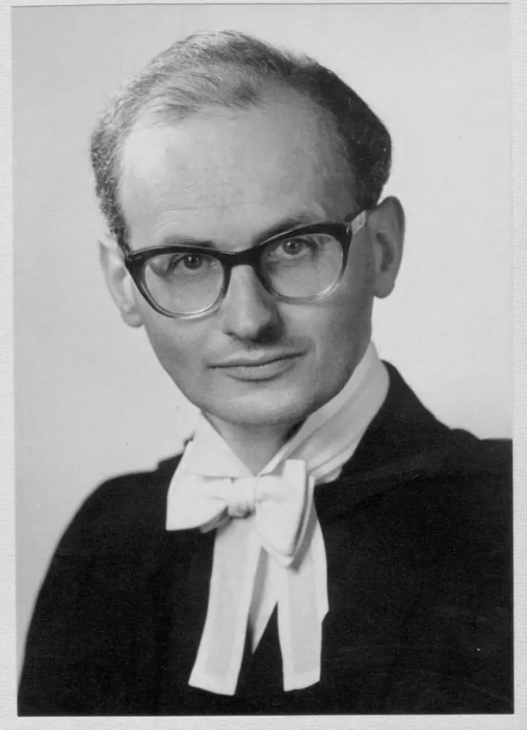
Book: Ecological detective
(Mangel 1997)
Core and belt beliefs. Core cannot be challenged but belt is routinely tested.
Hypothesis is rejected only when better one exists. Confrontation is therefore between multiple hypotheses
AIC testing
Bayesian and likelihood inference
1977
Lakatos

Slide 24
Kuhn, Popperian Science, Truth
Which view of science is closest to you? Popper (falsifiability), Polanyi (apprenticeship), Kuhn (paradigm shifts), Lakatos (core and belt beliefs).
Which is the most powerful way of studying nature? Induction or deduction, descriptive approach or hypothesis testing? What approach fits what questions? Give examples.
What are the strengths and limitations of different tests? P – values, AIC, likelihood and Bayesian statistics. Give examples of questions to be tested by the different methods.

Slide 25
Kuhn, Popperian Science, Truth
(1) Kuhn – paradigm shifts
Science progresses via revolutionary changes, not gradual accumulation.
Normal science → anomalies → crisis → new paradigm.
Example: Newtonian physics → Einstein’s relativity (space & time redefined).
Shifts change questions, methods, training, and norms in the scientific community.
(2) Popper – falsifiability
Criterion of science = testability and refutability.
Emphasis on deduction: propose bold hypotheses, try to falsify them.
Modern use: hypothesis testing in biodiversity and other fields.
Strengths: clarity, self-correction. Limits: Null hypotheses are always falsified.
(2) Theories as approximations of truth
Each model is a step closer to reality, never final. Truth is never final?
Example: Atomic theory from Dalton → quantum mechanics.
Combines Kuhn + Popper: revolutions + falsification refine models.
Implication: well-supported theories but openness to their revision with new evidence.

Slide 26
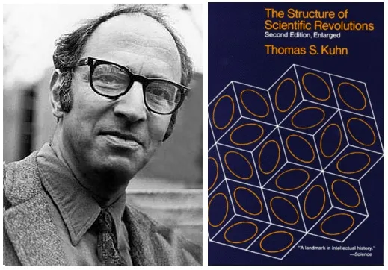
The Structure of Scientific Revolutions
Paradigms: Kuhn introduces the concept of a "paradigm," a framework of theories, methods, and standards that define legitimate research within a scientific community.
Normal Science: During periods of "normal science," scientists work within an established paradigm, solving puzzles and refining theories without questioning the underlying framework.
Anomalies: Anomalies are observations or problems that cannot be explained by the current paradigm. Initially, these anomalies are often ignored or considered errors.
Crisis: As anomalies accumulate, the existing paradigm faces increasing scrutiny, leading to a crisis. The scientific community begins to doubt the validity of the current framework.
Revolution: A scientific revolution occurs when a new paradigm emerges that better explains the anomalies and offers a new framework for research. This shift is not gradual but a fundamental transformation in scientific thinking.
Incommensurability: Kuhn argues that paradigms are incommensurable, meaning they cannot be directly compared because they involve different sets of concepts and standards. Scientists working within different paradigms may interpret data and concepts in fundamentally different ways.
Progress Through Revolutions: Scientific progress is not linear but occurs through a series of revolutions, where each new paradigm replaces the old one, leading to a deeper and more comprehensive understanding of nature.
1962

Slide 27
The Structure of Scientific Revolutions
Paradigms: Kuhn introduces the concept of a "paradigm," a framework of theories, methods, and standards that define legitimate research within a scientific community.
Normal Science: During periods of "normal science," scientists work within an established paradigm, solving puzzles and refining theories without questioning the underlying framework.
Anomalies: Anomalies are observations or problems that cannot be explained by the current paradigm. Initially, these anomalies are often ignored or considered errors.
Crisis: As anomalies accumulate, the existing paradigm faces increasing scrutiny, leading to a crisis. The scientific community begins to doubt the validity of the current framework.
Revolution: A scientific revolution occurs when a new paradigm emerges that better explains the anomalies and offers a new framework for research. This shift is not gradual but a fundamental transformation in scientific thinking.
Incommensurability: Kuhn argues that paradigms are incommensurable, meaning they cannot be directly compared because they involve different sets of concepts and standards. Scientists working within different paradigms may interpret data and concepts in fundamentally different ways.
Progress Through Revolutions: Scientific progress is not linear but occurs through a series of revolutions, where each new paradigm replaces the old one, leading to a deeper and more comprehensive understanding of nature.

Slide 28
Pattern is established
it calls for an explanation

Slide 29
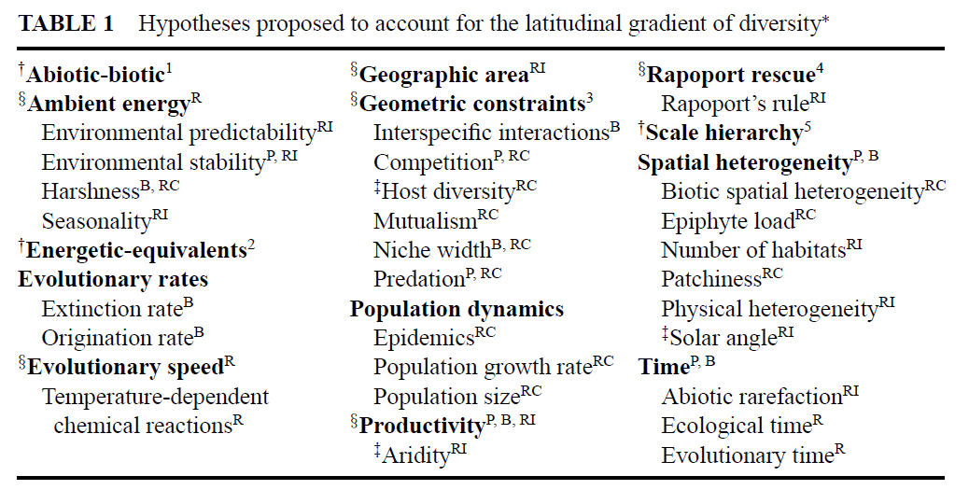
more than hundred explanations have been proposed
Willig et al. 2003 AREES

Slide 30
Two classes of explanations:
Regional environment Regional history
govern regional diversity

Slide 31
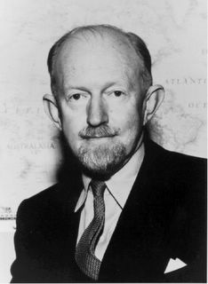
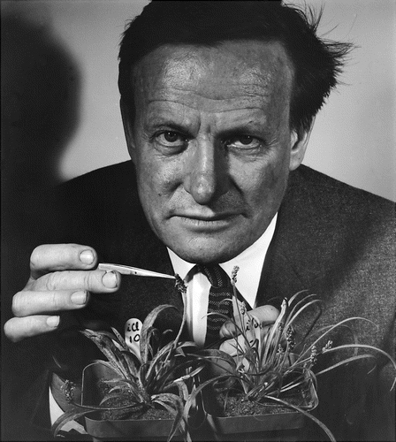
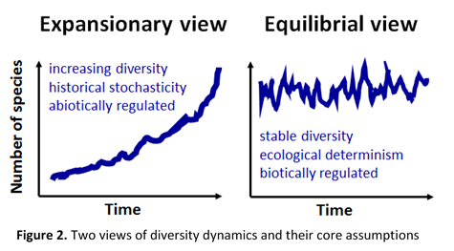
Regional environment
Regional history
Number of species
Equilibrial view
Historical view
Notes:
Two mutually opposite views have emerged from these debates. Two different schools of thought, if you will. The equilibrial view claims that the diversification process is bounded, governed by environmental factors (such as climate and resources) and therefore ecologically deterministic.
The historical view claims the exact opposite. Namely, that the diversification process is unbounded and contingent on numerous factors, including complex species interactions, which make the diversification process highly stochastic. Both views have received some support.

Slide 32
Divide between equilibrial and historical views of diversity dynamics
Two schools of biological thought
One emphasizes the roles of regional environment, present-day conditions (energy, climate, resources) >>> equilibrial view
The other one emphasizes the roles of regional history, evolutionary processes (historical contingency, mass extinctions, time, diversification rates) >>> historical view

Slide 33
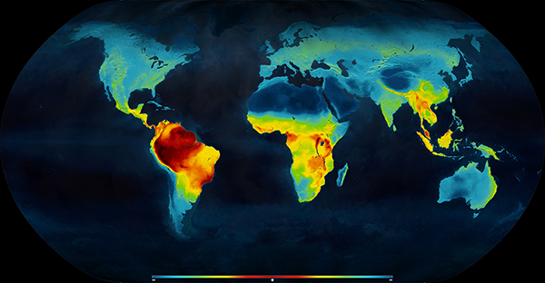
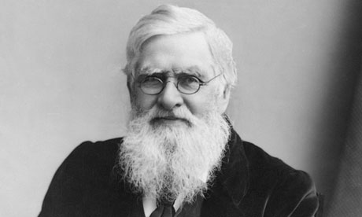
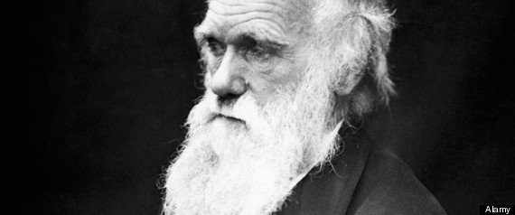
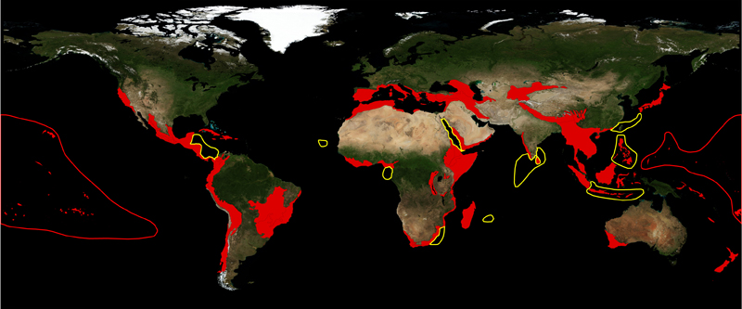
Equilibrial view
Historical view
Universal diversity gradients
Diversity anomalies
Darwin (1859)
Wallace (1878)
Notes:
It is well-known, for example. That many taxa follow the same diversity gradients, despite their dramatically different history. This suggests that these gradients were shaped deterministically by climate and environmental resources. In line with the equilibrial view.
On the other hand, there are many diversity anomalies (such as the Wallace’s line) that would be difficult to explain, using climate alone, without the knowledge of history.

Slide 34
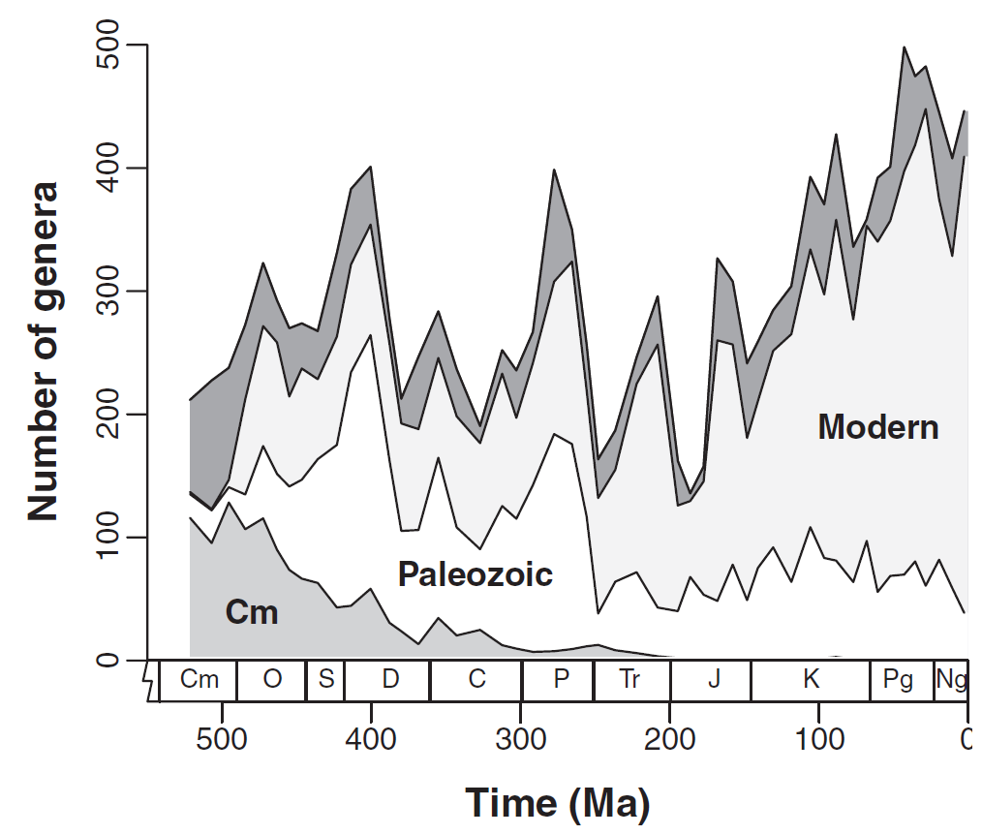
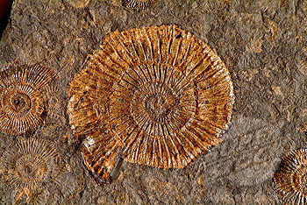
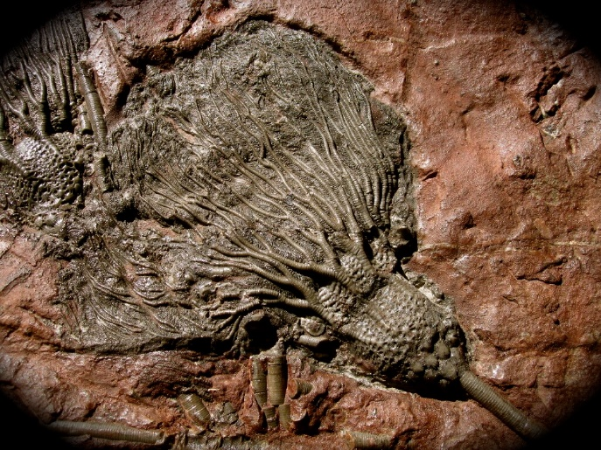
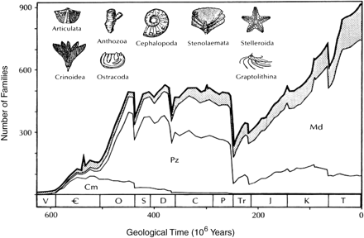
Equilibrial view
Historical view
Stable paleodiversity
Expanding paleodiversity
Alroy (2010) Science
Sepkoski (1990) Paleobiology
Notes:
The fossil record further suggests that marine diversity has increased steadily over time, as the famous Sepkoski’s series illustrates. Which supports the historical view.
But recent revisions of this very same data under different sampling corrections suggest that diversity may have been remarkably stable, in line with the equilibrial view.

Slide 35
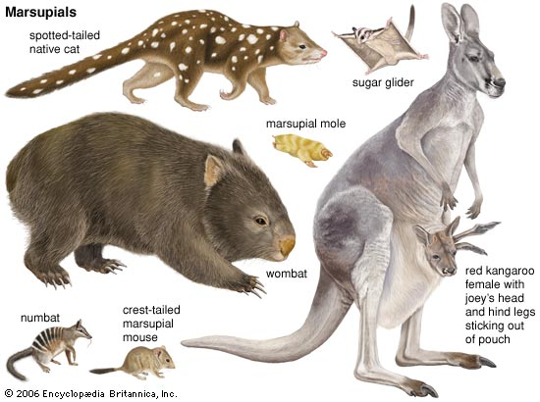
Equilibrial view
Historical view
Convergent faunas
Unique life forms
Anolis lizards in the Caribbean
Hawaiian honeycreepers
Australian marsupials
Notes:
And finally. Island faunas often reinvent forms and functions known from the mainland, suggesting that diversification is deterministic and equilibrial.
Yet, even among these convergent faunas, Australian marsupials, for example, unique life-forms occasionally emerge. Such as kangaroos. That do not have any analogue among placental mammals.

Slide 36
Examples of empirical studies

Slide 37
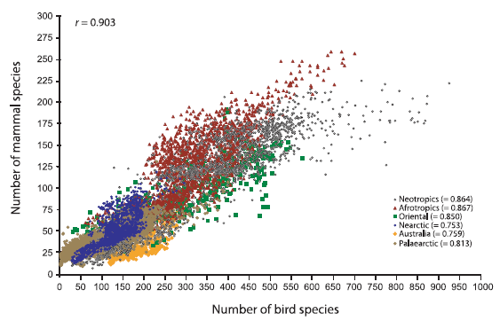
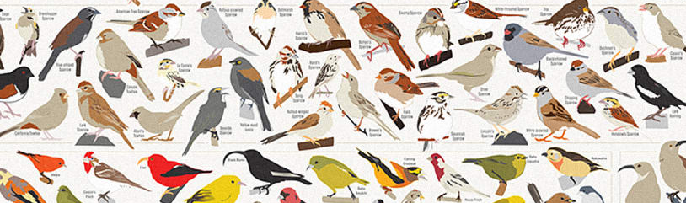
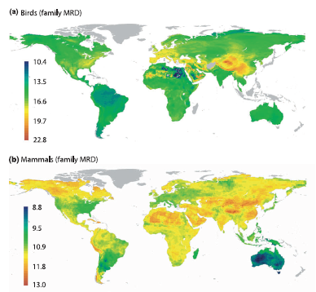
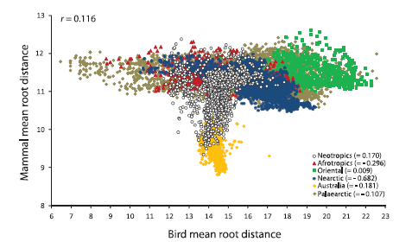
Regional environment produces convergent diversity patterns in birds and mammals worldwide, regardless of regional history
Hawkins et al. (2012) Journal of Biogeography
Notes:
Another example for birds and mammals.

Slide 38

Regional history, rather than regional environment, determines species and functional diversity of mangroves

Slide 39




Mid-elevation peak in hylid richness is explained by time
Most species of hylid glassfrogs occur at mid-elevations in the Andes. The pattern is best predicted by time (despite the recent uplift of the Andes). Also, rates of elevational change are coupled with climatic niche-evolution, supporting the role of niche conservatism in forming richness patterns
Hutter et al. (2013) EcolLett
Notes:
Emprical example. Glassfrogs show higherst richness at mid-elevations – high diversification, much time, many resources. They found that time is the best predictor of richness. Glassfrogs originated at the mid-elevations and spread into the lowlands and into the highlands
Additionally, the authors considered also a non-biological (geometric) explanation. That was not supported. This explanation is a null model, based on the reshuffling of species’ elevational ranges. Like a box of crayons (different lengths, reshuffled, open the box). Highest number of crayons will be in the middle. Most species often found at mid-elevaitons.
The same can apply to latitude. Most species at mid-latitudes – which is in the tropics, at the equator. These were popular. But later rejected. Conceptually and empirically
Study supports the historical explanation (time for speciation, combined with niche conservatism)

Slide 40
Biodiversity anomalies
Exceptions that do not fit, seem to reflect historical contingency
Evolutionary history (extinction refuges, diversity cradles, islands)
Can you name some of the regions that stand out?
What do they have in common?

Slide 41

Myers et al. 2000 (Nature)
Biodiversity anomalies
Exceptions that do not fit, seem to reflect historical contingency
Evolutionary history (extinction refuges, diversity cradles, islands)
Can you name some of the regions that stand out?
What do they have in common?

Slide 42
The causes of diversity patterns have not been convincingly resolved yet
Perhaps there is no clear answer, or the question cannot be resolved based on present-day evidence. Dead-end in biological science?
But has inspired research that has advanced our understanding of nature

Slide 43


The scale controversy
Some studies find that number of species is best explained by
competition
landscape heterogeneity
climate
This generates conflicts across empirical studies that are hard to reconcile
Resolution: What is a locality, what is the area over which the number of species is counted?

Slide 44
The scale controversy
Some studies find that number of species is best explained by
competition
landscape heterogeneity
climate
This generates conflicts across empirical studies that are hard to reconcile
Resolution: What is a locality, what is the area over which the number of species is counted?

Slide 45

Biodiversity patterns are
geographic scale dependent
competition
landscape heterogeneity
climate

Slide 46
Multiple processes govern diversity
Biogeographic processes occur over long temporal scales. Dispersal varies with the mobility of the organism and can alter patterns of species distributions established through ecological sorting processes. At decreasing spatial scales, the environment filters out species lacking the physiological tolerances that permit persistence, given the climate or local environmental conditions. The environment can include both abiotic factors (temperature, soil moisture, light availability, pH) or biotic factors (symbionts, pollinators, hosts, prey). Density-dependent processes are likely to operate most intensively at neighbourhood scales. These processes may include competition, disease, herbivory, interspecific gene flow, facilitation, mutualism, and may interact with the abiotic environment to reinforce or diminish habitat filtering. At a given spatial scale (e.g., A), species distributions depend on multiple factors, which may be difficult to tease apart. Methods that can partition the variance among causal factors driving community assembly facilitate understanding of mechanism.

Slide 47
The processes are differentially influential across scales
Scale matters
Different processes (biotic interactions, dispersal, speciation and extinction) govern biodiversity
across geographic and temporal scales

Slide 48
The processes are differentially influential across scales
Scale matters
Different processes (biotic interactions, dispersal, speciation and extinction) govern biodiversity
across geographic and temporal scales

Slide 49
The processes are differentially influential across scales
Scale matters
Different processes (biotic interactions, dispersal, speciation and extinction) govern biodiversity
across geographic and temporal scales

Slide 50

The scale controversy
Seemingly conflicting results can be reconciled, when considering that they hold at different scales
The problem of pattern and scale in ecology (Levin 1994)

Slide 51
can we combine this knowledge into theory?

Slide 52
Developing theory
What process would generate the pattern?
The pattern is the correlation (e.g. diversity~latitude)
(1) Kinetic effects of temperature
(2) Metabolic theory
(3) Energy limits
(4) Geometric constraints

Slide 53
faster speciation in warmer regions
Hughes et al. (2006) PNAS

Slide 54

Temperature kinetics
Probability of speciation, extinction, and colonization grows multiplicatively with temperature or energy (= Arrhenius kinetics for metabolic rate, diversification as a Poisson process with a rate depending on temperature).
Form: straight line on semi-log plot
Shape: Purely accelerating increase (or decrease) with predictor. No upper bound.
Implication: Each unit increase in energy multiplies richness by a constant factor.
Difference from power law: Power law implies proportional change in relative terms, while exponential implies proportional change in absolute rate.
Prediction: Exponential relationship

Slide 55

scaling relationships in ecology
Brown et al. (2004) 9000+ citations. Metabolic rate changes with temperature and body mass. This connects with a variety of other patterns, including correlations with population size, population density, rates of molecular divergence and speciation

Slide 56

Metabolic theory
Energy availability and temperature affect speciation/extinction rates through metabolic rates. This produces allometric scaling (power laws) between diversity and energy/temperature.
Form: log–log plot is a straight line
Shape: Concave upward on raw scale
Implication: No hard ceiling. Richness keeps increasing proportionally with energy, but at diminishing or accelerating rates depending on parameter b. Predicts self-similarity and scale invariance.
Prediction: Power-law relationship

Slide 57

Currie (1991) 2200+ citations

Slide 58

Energy limits
Energy limits species coexistence. But above some energy or productivity level, other factors (habitat heterogeneity, biotic interactions, evolutionary time) become limiting, and additional energy does not lead to more species.
Form:
Michaelis–Menten or logistic relationship
Shape: Initially steep rise with energy but levels off to a maximum.
Implication: Predicts a ceiling to richness at high energy—common in productivity–diversity models.
Prediction: Saturating (asymptotic) relationship

Slide 59

Theory
Mechanism
Prediction
Metabolic theory
Kinetic theory
Energy limits

Slide 60

Geometric constraints explain much of the species richness in African birds
Species ranges of 1100+ birds placed randomly within the bounds of the African continent. The richness under this null model remarkably resembles the observed richness of birds. The contraints therefore may have significantly contributed to the formation of the geographic patterns in bird richness
Jetz and Rahbek (2001) PNAS
Notes:
Another example would be from the geographic patterns species richness of birds. Here we see communities of birds within a regular grid covering Africa. The number of species is the highest across the dark grid cells
Can we design a simple null model that would produce this pattern? What would be the null model, the null expection?

Slide 61
Null model: Geometric constraints
Mid-domain effect: On a bounded domain, species ranges placed randomly must overlap most in the middle of the domain.
This purely geometric property yields a richness peak at the equator even without environmental gradients.
The mechanism: species ranges cannot extend beyond the boundary, so they are “compressed” toward the centre, creating a stacking of ranges near the equator.
Use: a baseline for testing whether observed LDG exceeds what geometry alone would produce.
Prediction: richness peaks at mid-latitudes and mid-elevations

Slide 62
Mid-elevation peak in hylid richness is explained by time
Most species of hylid glassfrogs occur at mid-elevations in the Andes. The pattern is best predicted by time (despite the recent uplift of the Andes). Also, rates of elevational change are coupled with climatic niche-evolution, supporting the role of niche conservatism in forming richness patterns
Hutter et al. (2013) EcolLett
Notes:
Emprical example. Glassfrogs show higherst richness at mid-elevations – high diversification, much time, many resources. They found that time is the best predictor of richness. Glassfrogs originated at the mid-elevations and spread into the lowlands and into the highlands
Additionally, the authors considered also a non-biological (geometric) explanation. That was not supported. This explanation is a null model, based on the reshuffling of species’ elevational ranges. Like a box of crayons (different lengths, reshuffled, open the box). Highest number of crayons will be in the middle. Most species often found at mid-elevaitons.
The same can apply to latitude. Most species at mid-latitudes – which is in the tropics, at the equator. These were popular. But later rejected. Conceptually and empirically
Study supports the historical explanation (time for speciation, combined with niche conservatism)

Slide 63
Null model: Geometric constraints
Mid-domain effect: On a bounded domain, species ranges placed randomly must overlap most in the middle of the domain.
This purely geometric property yields a richness peak at the equator even without environmental gradients.
The mechanism: species ranges cannot extend beyond the boundary, so they are “compressed” toward the centre, creating a stacking of ranges near the equator.
Use: a baseline for testing whether observed LDG exceeds what geometry alone would produce.
Prediction: richness peaks at mid-latitudes and mid-elevations

Slide 64
latitudes
and elevations
1799
amphibians
Notes:
One of the key figures in the study of nature is Alexander von Humboldt. Historians of science actually credit Humboldt with the “invention of nature”. The concept of nature supposedly did not historically exist before he formulated it through his work. We therefore now have nature as subject of study.
Humboldt also started retreats in the field. He also identified some of the key questions in biology. When he was about my age, he traveled into the Amazon. During his travels, he noticed that there are many more species in the tropics (compared to temperate) and many more species in lowlands (especially in the Andes) compared to the highlands.
Today, these patterns are known as the latitudinal diversity gradient. And the elevational diversity gradient.

Slide 65
latitudinal and elevational gradients
Are elevational gradients replicates of latitudinal gradients? Can we use them as nature’s laboratories, what are the similarities between these gradients? What questions can be answered for elevations, but not for latitudes?
How are the gradients different? Consider the effects of geographic scale, temporal scale, processes that operate within mountains and continents worldwide. When would you expect the gradients to differ?

Slide 66
Theory
Mechanism
Prediction
Metabolic theory
Kinetic theory
Energy limits

Slide 67
Theory
Mechanism
Prediction
Metabolic theory
Kinetic theory
Energy limits
Which theory to trust?

Slide 68
P – value
H₀: There is no relationship
species richness
latitude

Slide 69
P – value
This is my observed data
species richness
latitude

Slide 70
P – value
This is my observed data
species richness
latitude

Slide 71
P – value
What is the probability of observing data that is this extreme, assuming that the null hypothesis holds?
species richness
latitude

Slide 72
P – value
H₀: There is no relationship
species richness
latitude

Slide 73
P-value approach cannot help me decide between these three explanations for LDG

Slide 74
P-value approach cannot help me decide between these three explanations for LDG
Popper
Polanyi

Slide 75
Model fitting: Likelihood
What is the probability with which the data has been produced by a given model?
probability and likelihood
observed data
empirical pattern
evaluated model
assumed process
Notes:
Model fitting is typically implemented using maximum likelihood
We ask: which model is most likely to have generated our data?
Which process is most likely to have generated the pattern?

Slide 76
Model fitting: Likelihood
What is the probability with which the data has been produced by a given model?
probability and likelihood
observed data
empirical pattern
evaluated model
assumed process
P (Data|Hypothesis)
P (Hypothesis|Data)
Notes:
Model fitting is typically implemented using maximum likelihood
We ask: which model is most likely to have generated our data?
Which process is most likely to have generated the pattern?

Slide 77
Model fitting: Likelihood
What is the probability with which the data has been produced by a given model?
probability and likelihood
observed data
empirical pattern
evaluated model
assumed process
Probability with which an assumed process (evaluated model) would produce the empirical pattern (observed data) = likelihood of the model

Slide 78
Model fitting: Likelihood
What is the probability with which the data has been produced by a given model?
probability and likelihood
observed data
empirical pattern
evaluated model
assumed process
Concept | Known | Unknown | Question
Probability | Parameters | Data | How probable is this data under the model?
Likelihood | Data | Parameters | How likely is the model given this data?

Slide 79

What is the likelihood that the Moon is made of cheese?
Notes:
To illustrate on a perhaps more imaginative example

Slide 80
correcting likelihood values by incorporating further independent information (prior knowledge) is the basis of Bayesian inference. The results produce estimates of posterior probability.
What is the likelihood that the Moon is made of cheese?
Notes:
Likelihood is often coupled with prior knowledge – these two together are key ingredients of he bayessian inference
If you are interested in Bayesian inference – we can discuss it later – or over the exercises

Slide 81
Akaike’s information criterion
More complicated models are more likely to produce the observed data (empirical phylogeny, empirical pattern) simply because they have more parameters and therefore are more flexible.
We want to maximize likelihood while minimizing model complexity.
The objective is to get simple models that explain as much of the data as possible
likelihood balanced against model complexity
AIC = 2 ln (L) + 2k
Likelihood of the model (L)
model complexity
Number of model parameters (k)
Notes:
Once I fit the model, using maximum likelihood – I can calculate the likelihood of the model
How do I use likelihood to identify the best model?
Complex models are more likely to generate any pattern – I would like to know if the model explains as much as possible, given its complexity
The balance between explanatory power – and complexity – of the model is captured by AIC

Slide 82
Akaike’s information criterion
The formulate is derived from the information theory and entropy (Boltzmann) and cannot be deliberately modified to penalize for k
AIC represents the relative distance of the evaluated model from the truth
likelihood balanced against model complexity
AIC = 2 ln (L) + 2k
Likelihood of the model (L)
model complexity
Number of model parameters (k)
Notes:
It can proved mathematically that AIC represents the relative distance of the evaluated model from the truth
That’s why we prefer the model with the lowest AIC – closest to the truth

Slide 83
Akaike’s information criterion
Models are not the truth.
They are approximations of the truth.
likelihood balanced against model complexity
AIC = 2 ln (L) + 2k
Likelihood of the model (L)
model complexity
Number of model parameters (k)

Slide 84

Akaike’s weights
Rescaling AIC values to make comparison among candidate models within a given model set
Δ … difference between AIC of a given model and AIC of the best model within the model set
The weights correspond to the probability that a given model is the true model, given the model set, under the assumption that the true model is in the model set. Better interpretable than AIC.
Notes:
If we have a set of models – we can rescale the AIC into AIC weights – relative probability that a given model is the true model – under the condition that the true model is included in the model set
Good that its between 0 and 1
Easier to compare the relative support of different models

Slide 85

Akaike’s weights
Rescaling AIC values to make comparison among candidate models within a given model set
80%
19%
1%
The weights correspond to the probability that a given model is the true model, given the model set, under the assumption that the true model is in the model set. Better interpretable than AIC
Notes:
If we have a set of models – we can rescale the AIC into AIC weights – relative probability that a given model is the true model – under the condition that the true model is included in the model set
Good that its between 0 and 1
Easier to compare the relative support of different models

Slide 86
Evaluating model fit
Observed data – the shape of the latitudinal diversity gradient based on the empirical data
Model 1 – power law relationship
Model 2 – exponential relationship
Model 3 – logistic relationship
species richness
To compare model fit, we can use the likelihood of the model, likelihood ratio test (LRT), AIC, Akaike’s weights
latitude
Notes:
Likelihood ratio tests sometimes require the models to be nested. AIC is safer as this assumption is not invoked

Slide 87
Theory
Mechanism
Prediction
Metabolic theory
Kinetic theory
Energy limits
R exercise

Slide 88
Why are species non-randomly distributed in geographic space?
1799
amphibians
Notes:
One of the key figures in the study of nature is Alexander von Humboldt. Historians of science actually credit Humboldt with the “invention of nature”. The concept of nature supposedly did not historically exist before he formulated it through his work. We therefore now have nature as subject of study.
Humboldt also started retreats in the field. He also identified some of the key questions in biology. When he was about my age, he traveled into the Amazon. During his travels, he noticed that there are many more species in the tropics (compared to temperate) and many more species in lowlands (especially in the Andes) compared to the highlands.
Today, these patterns are known as the latitudinal diversity gradient. And the elevational diversity gradient.

Slide 89
Summary
Biologists have been fascinated by the diversity of life, which is surprisingly unevenly distributed in the geographic space.
We observe latitudinal gradients, elevational gradients, species-area relationships
These pattern are largely universal across continents and taxa, including bacteria, vascular plants, insects, vertebrates

Slide 90
Summary
Hundreds of explanations have been proposed (equilibrial, historical) based on a variety of mechanisms (metabolic rates, kinetics, energy)
Each of the explanation has received some support but each is insufficient to explain the gradient
The gradients are likely produced by interactions between multiple mechanisms across scales

Slide 91
1799
amphibians
Notes:
One of the key figures in the study of nature is Alexander von Humboldt. Historians of science actually credit Humboldt with the “invention of nature”. The concept of nature supposedly did not historically exist before he formulated it through his work. We therefore now have nature as subject of study.
Humboldt also started retreats in the field. He also identified some of the key questions in biology. When he was about my age, he traveled into the Amazon. During his travels, he noticed that there are many more species in the tropics (compared to temperate) and many more species in lowlands (especially in the Andes) compared to the highlands.
Today, these patterns are known as the latitudinal diversity gradient. And the elevational diversity gradient.

